Slide 1




Week-5 (Discussion)
22nd Aug, 2025
Computer Vision
Prof. Jayanta Mukhopadhyay
Professor
Computer Science and Engineering Department
IIT Kharagpur
Ayan Paul
PMRF Research Scholar
IIT Kharagpur

Slide 2
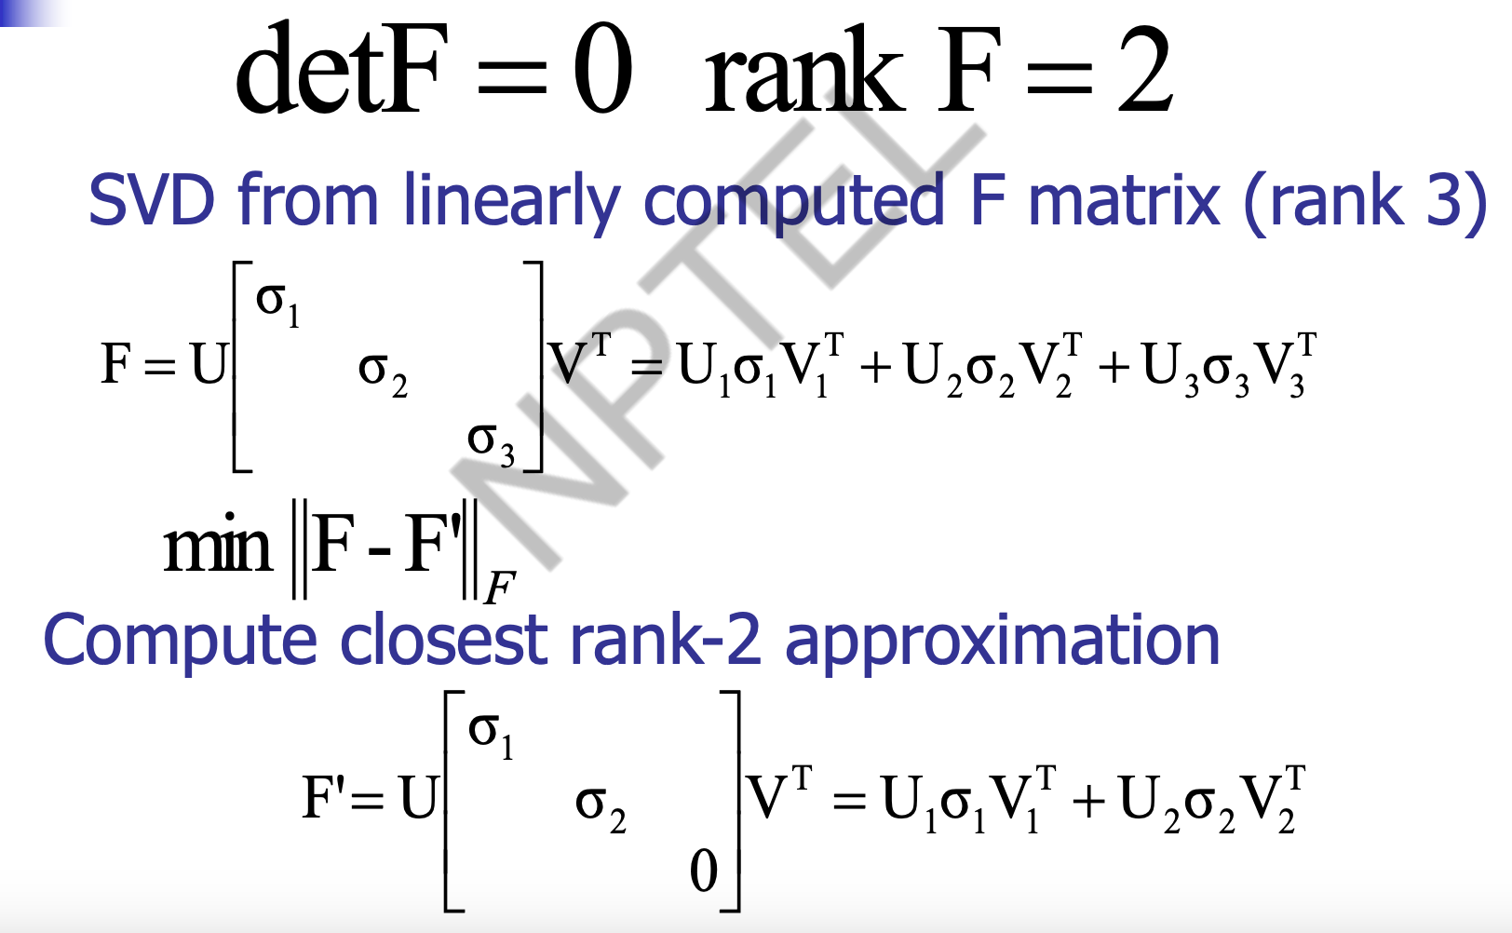
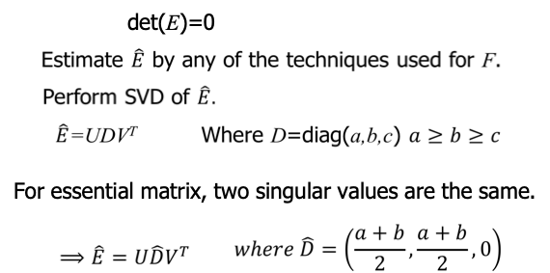
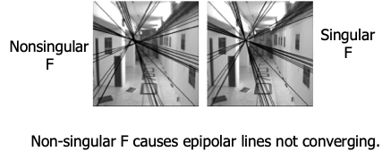
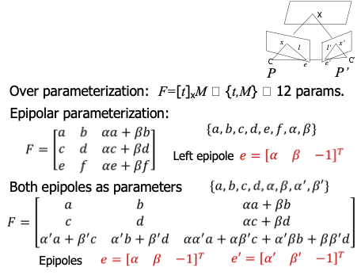
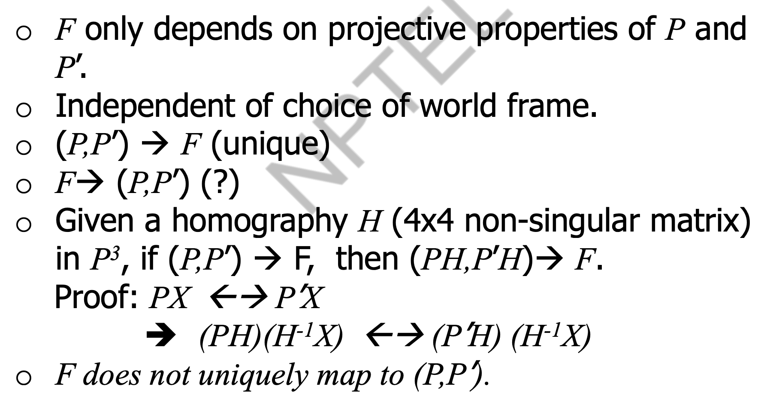
The singularity constraint
The singularity constraint for F
The singularity constraint for E
Parametric representation of F
Retrieving the camera matrices from F

Slide 3
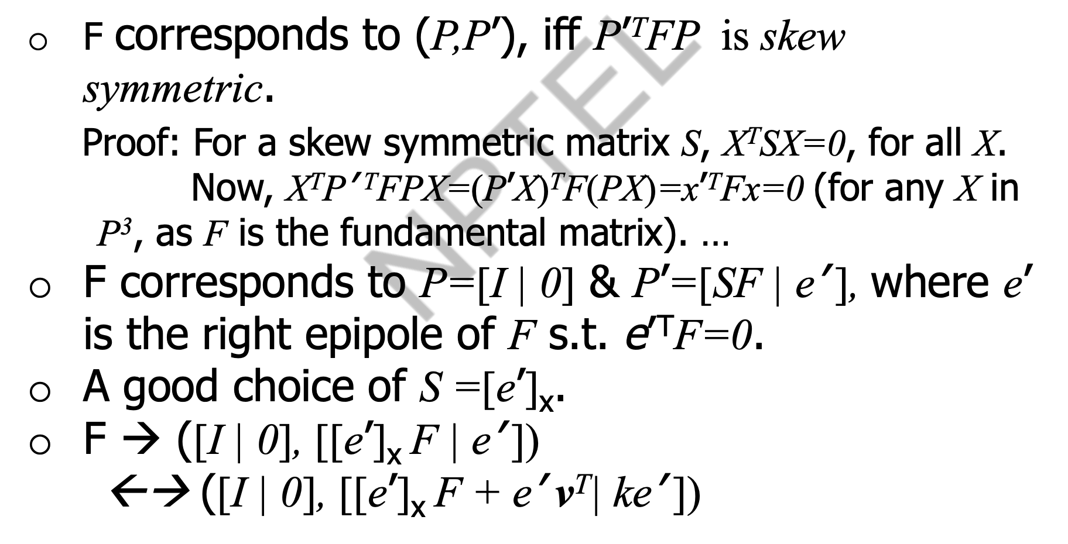
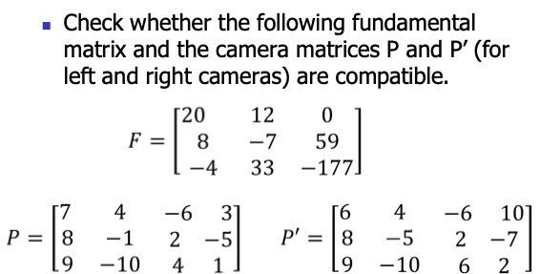
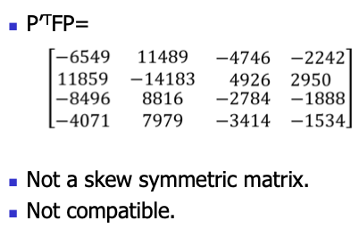
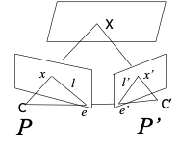
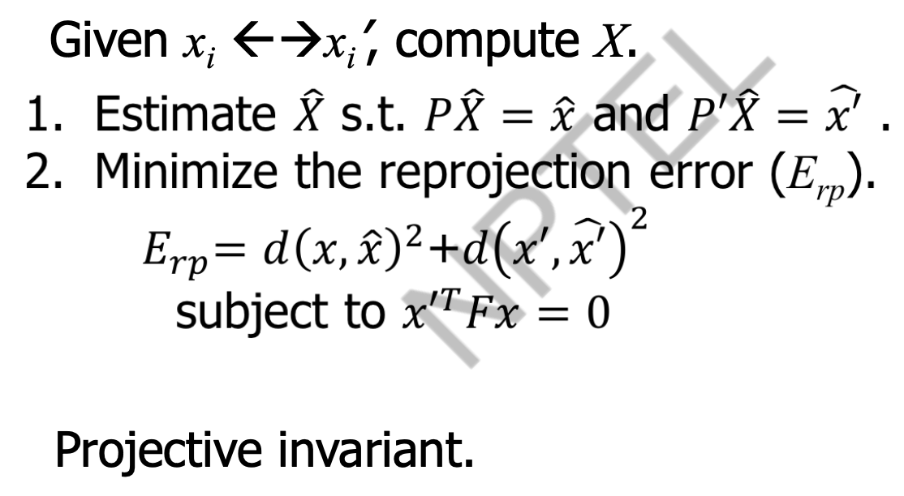
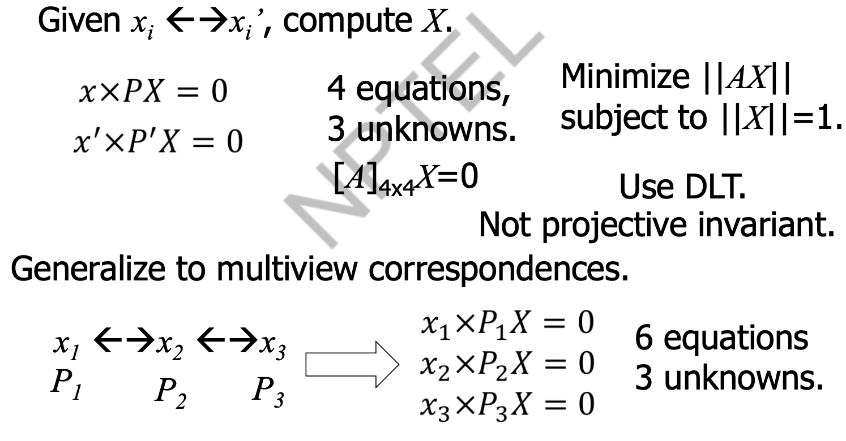
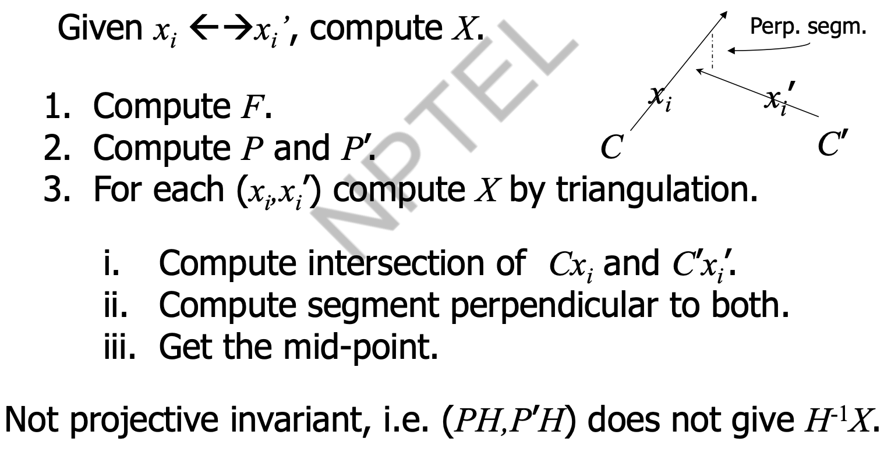
Property of retrieving the camera matrices from F
Exercise -1
Solution
Computing scene points
Computation of Structure
Minimizing Reprojection Error
Linear triangulation methods

Slide 4
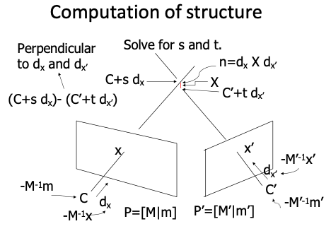
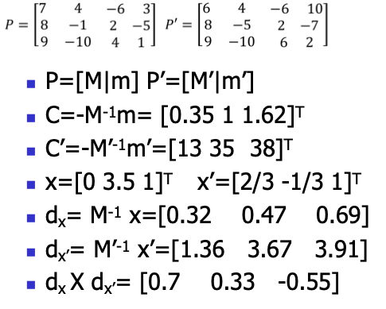
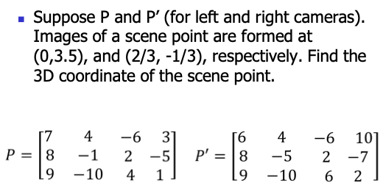
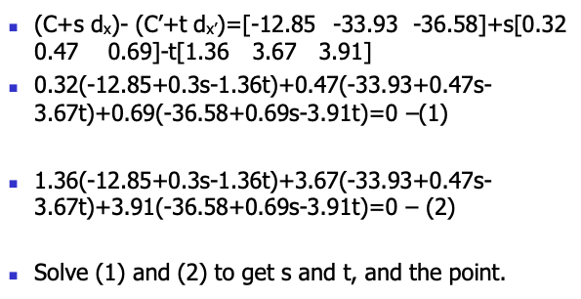
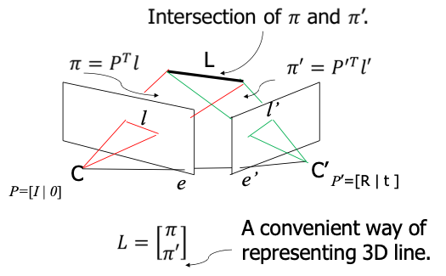
Solution
Exercise -2
Line reconstruction

Slide 5
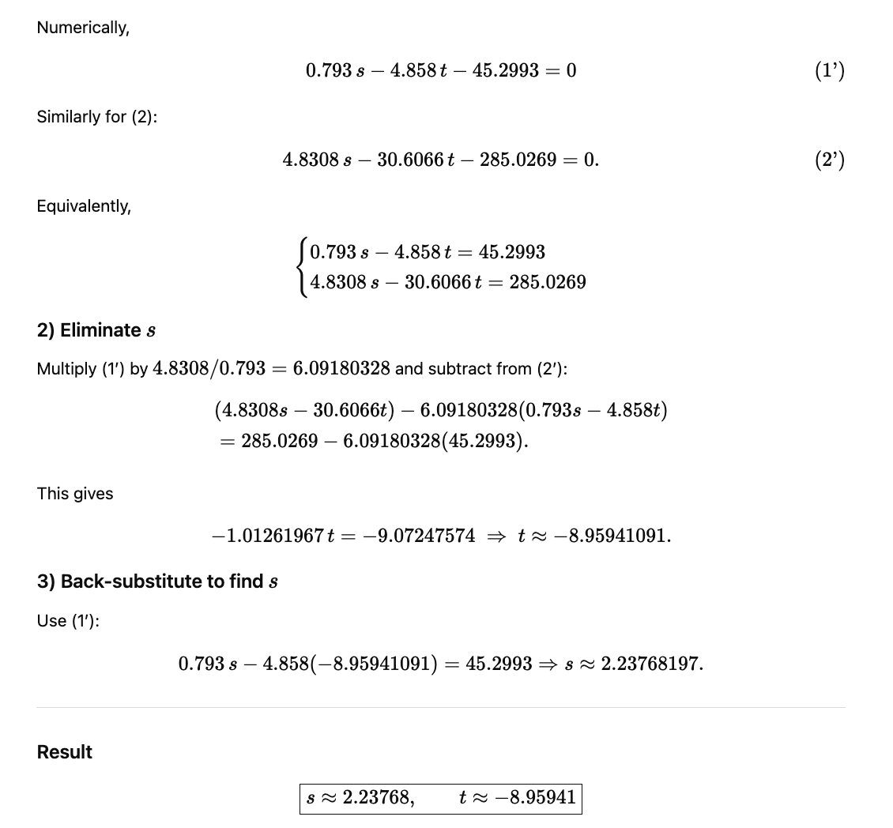
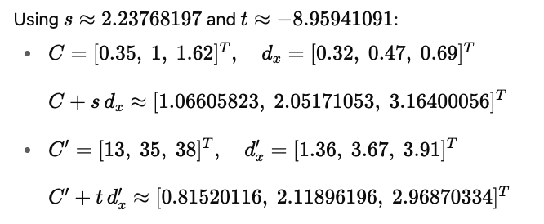
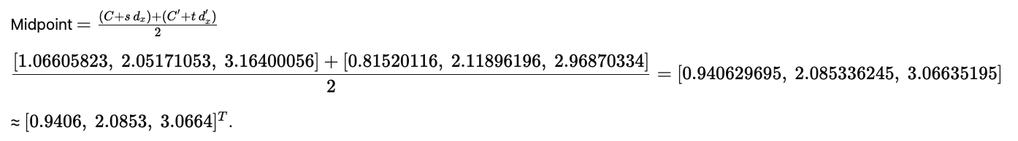

Slide 6
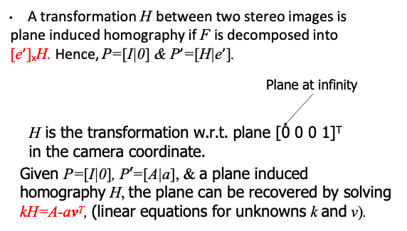
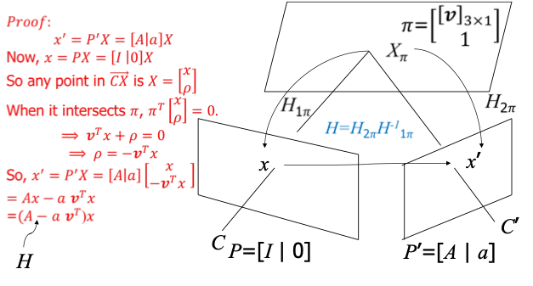
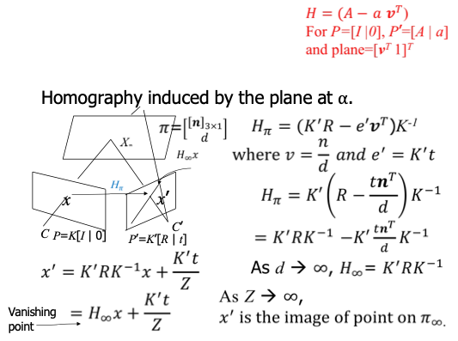
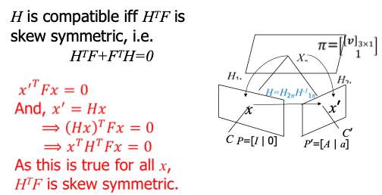
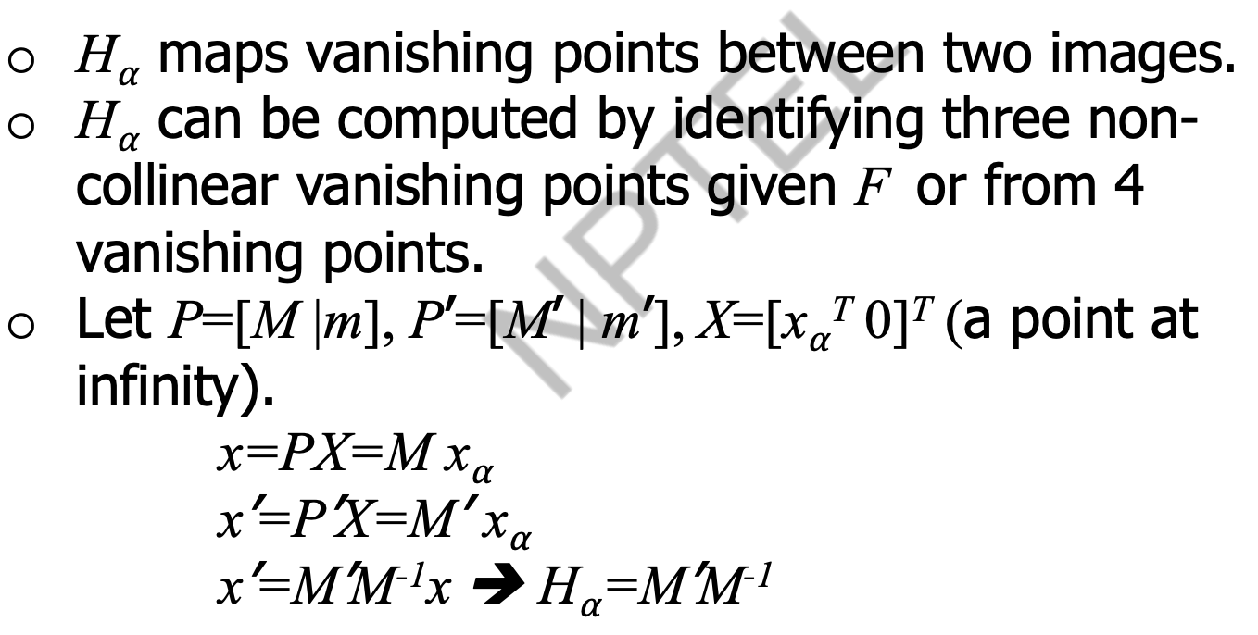
Plane-induced Homography
Infinite Homography
Homography-compatible stereo geometry
H⍺ and Vanishing points

Slide 7
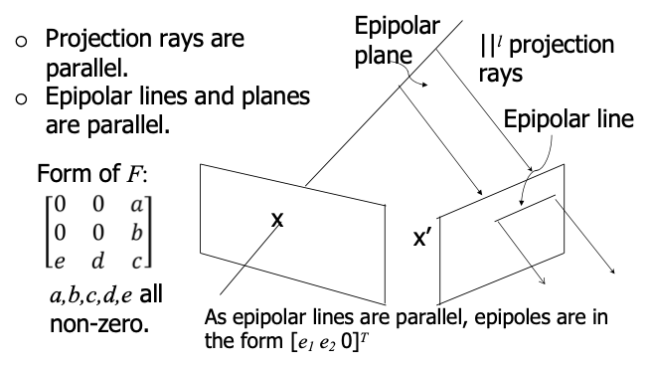
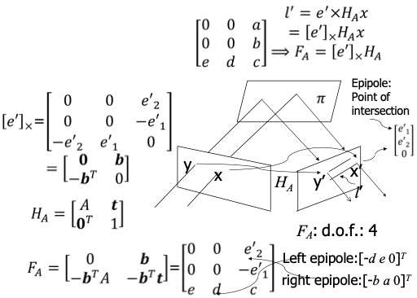
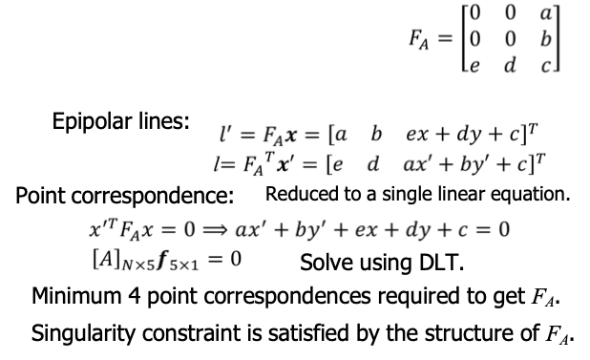
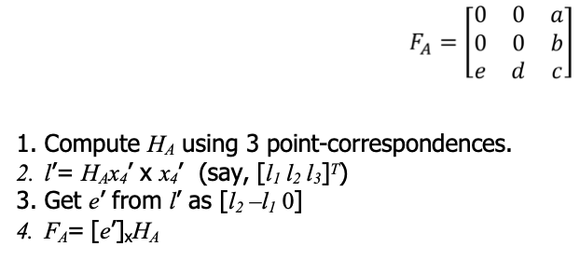
Affine epipolar geometry
Affine stereo
Estimating F_{A}
Estimating F_{A}
(Another approach)

Slide 8
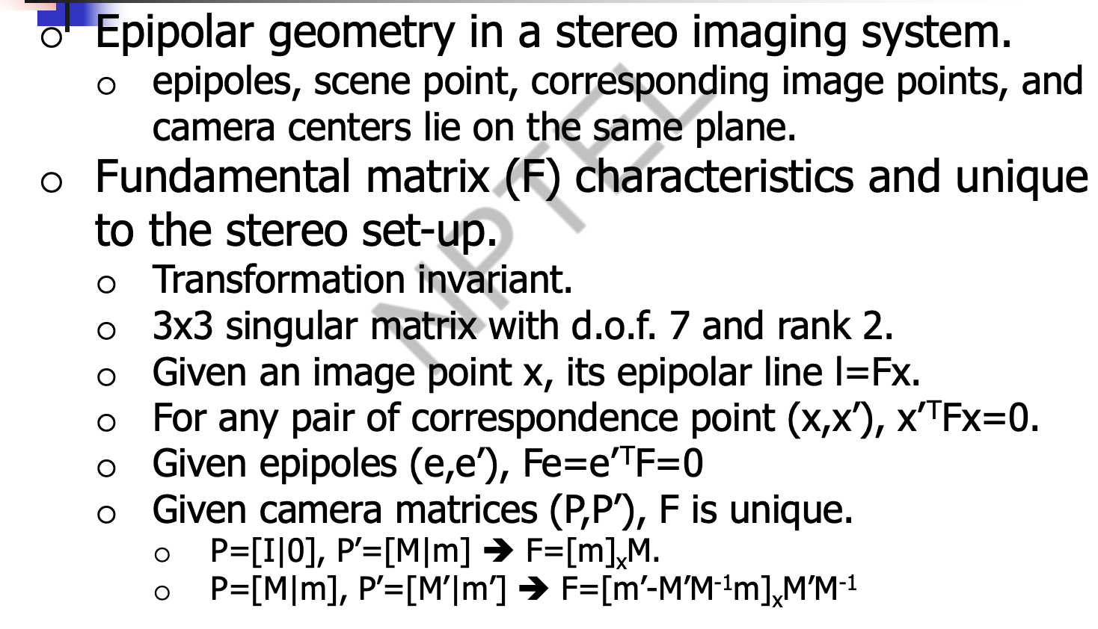
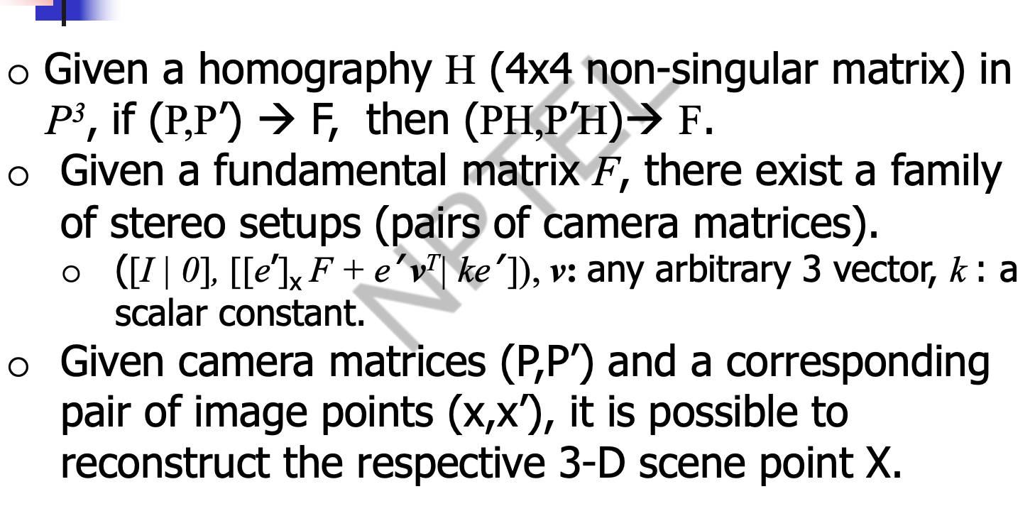
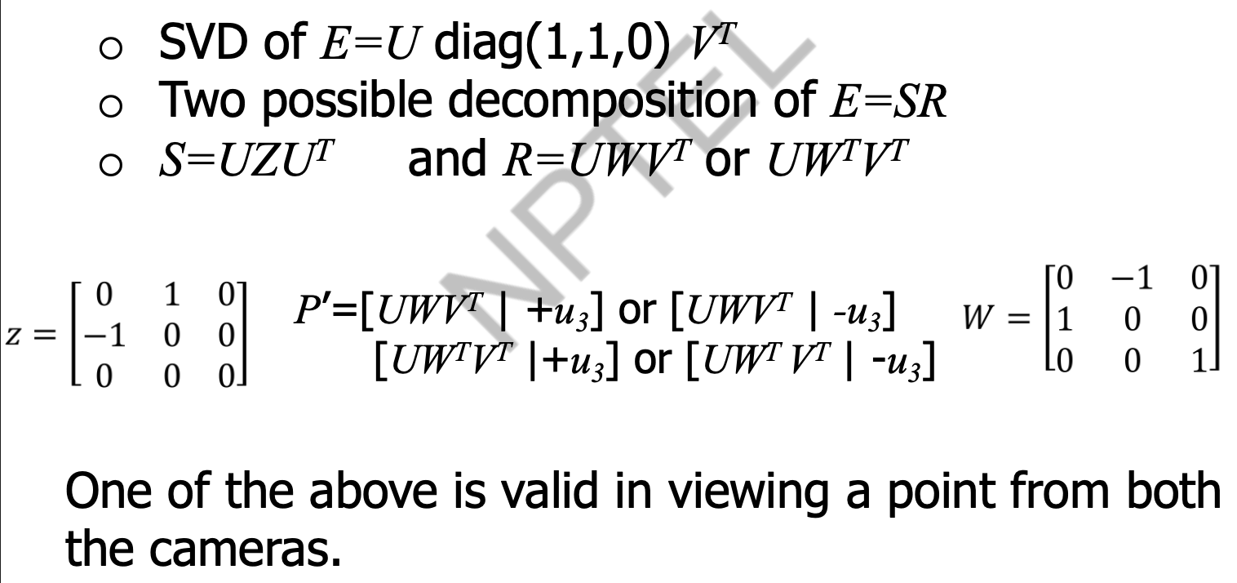
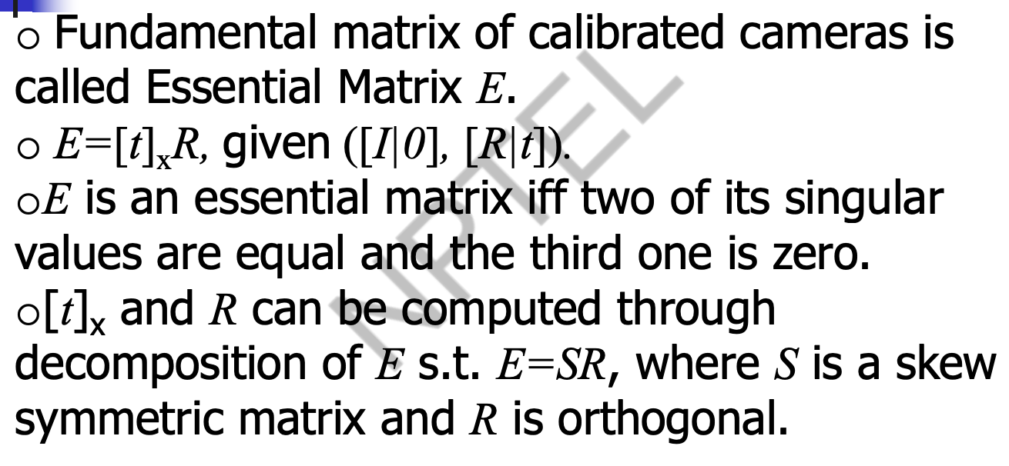
Stereo geometry Summary

Slide 9
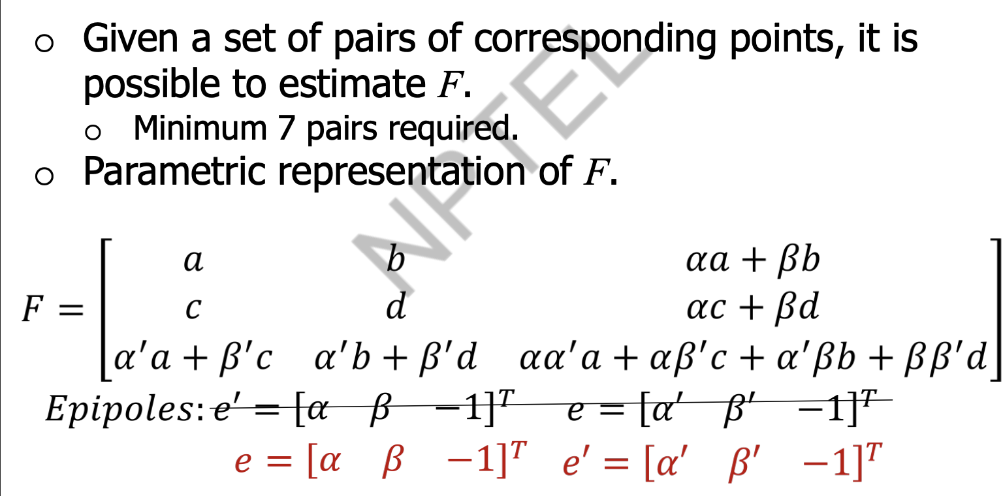
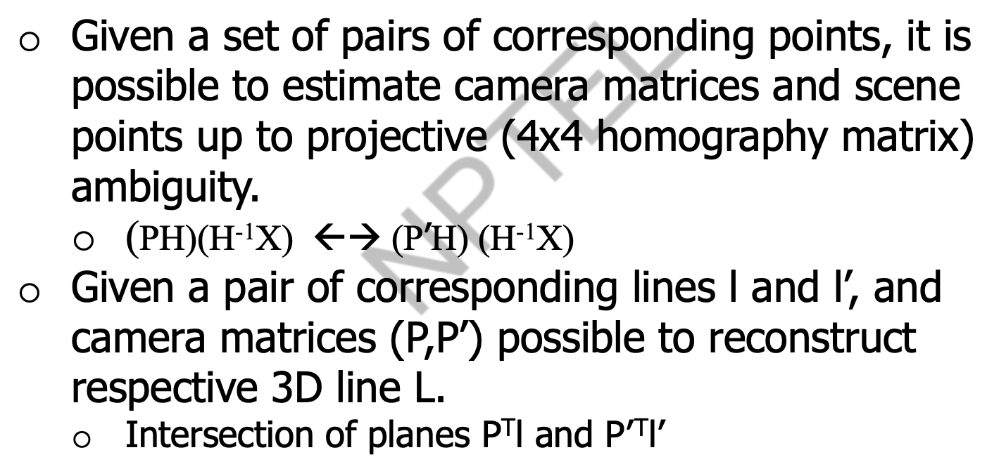
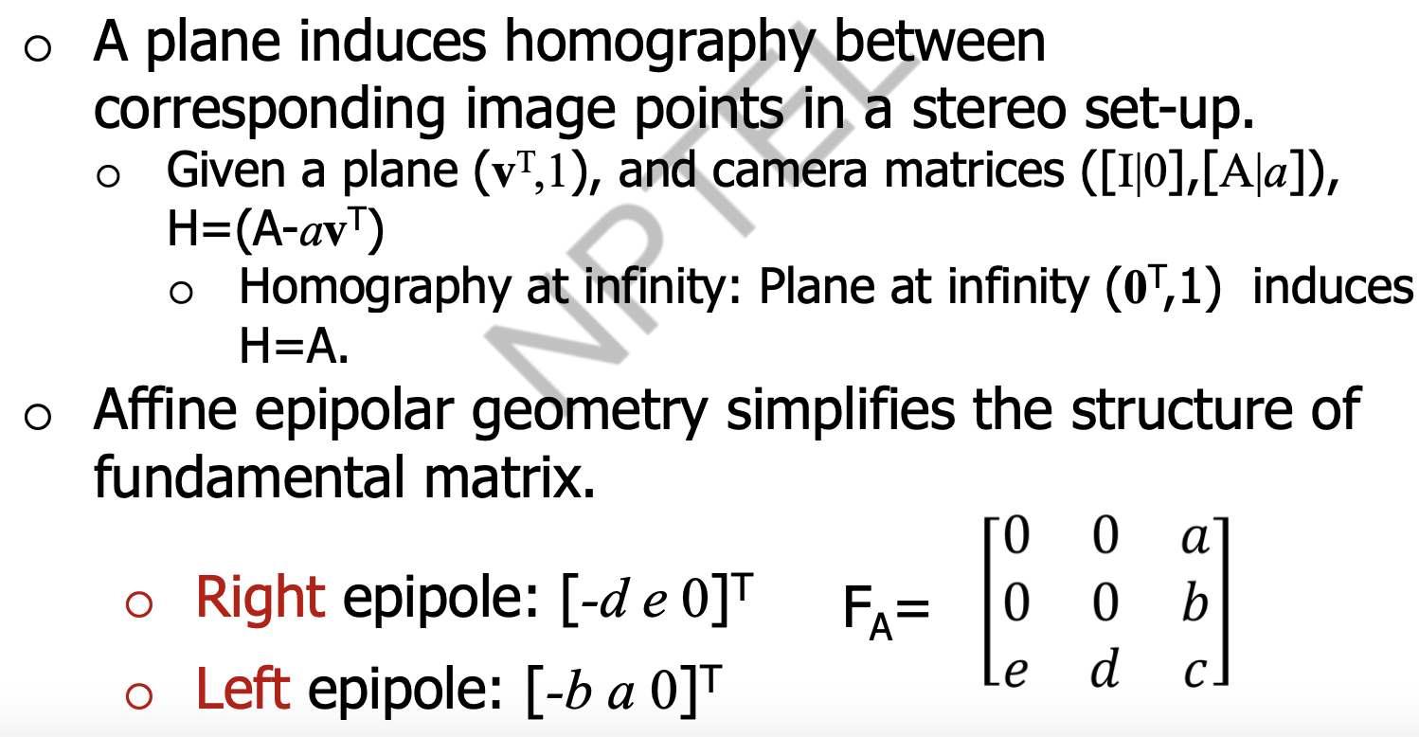

Slide 10


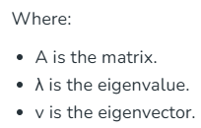
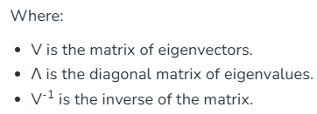
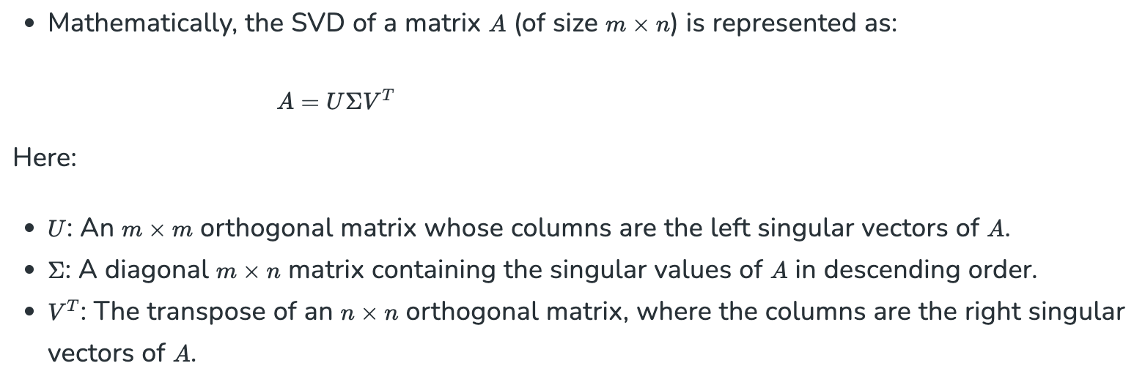
Eigen Value Decomposition
Eigen decomposition is a method used in linear algebra to break down a square matrix into simpler components called eigenvalues and eigenvectors.
This decomposition is significant because it transforms matrix operations into simpler, scalar operations involving eigenvalues, making computations easier.
Singular Value Decomposition
It generalizes the Eigen value decomposition of a square matrix with an orthonormal eigen basis to any ⁠m × n matrix.

Slide 11
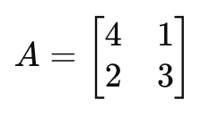
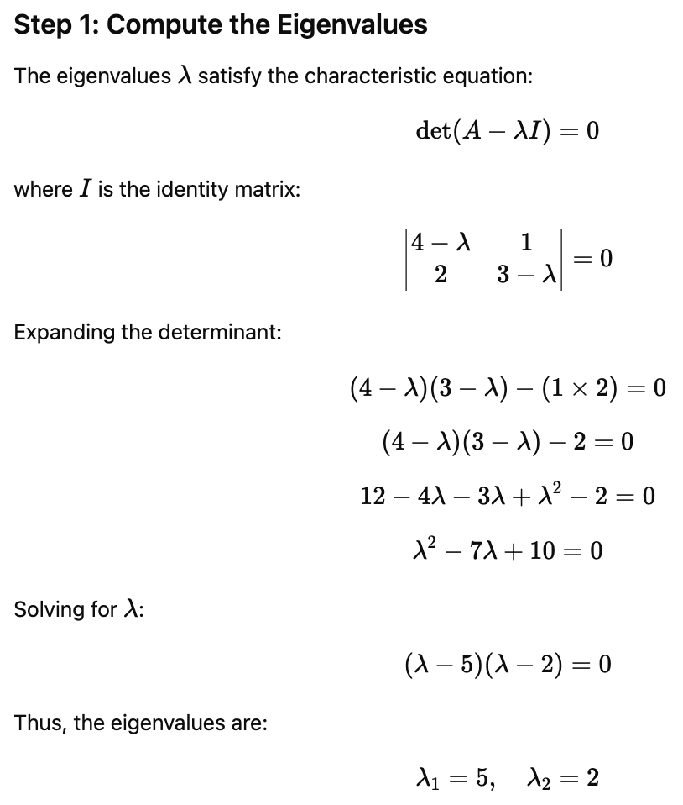
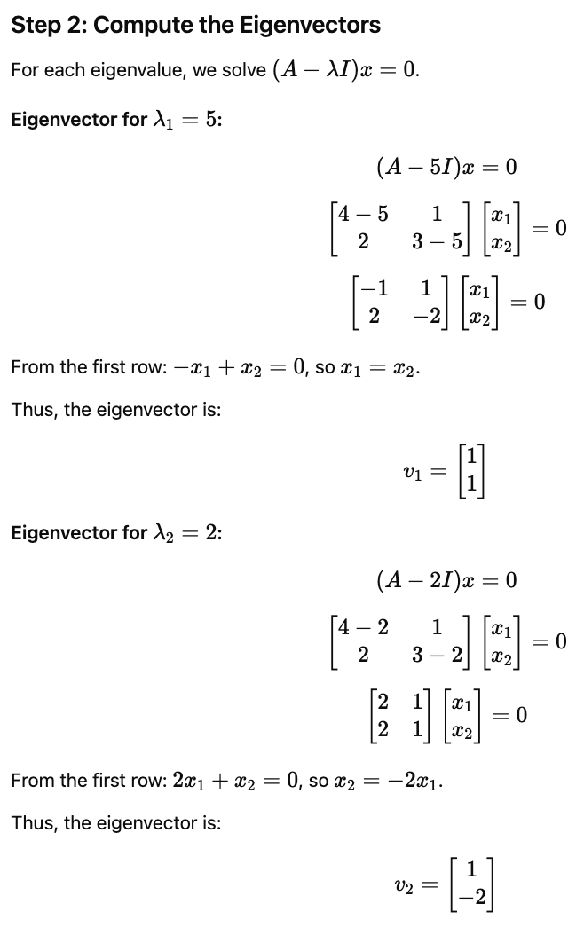
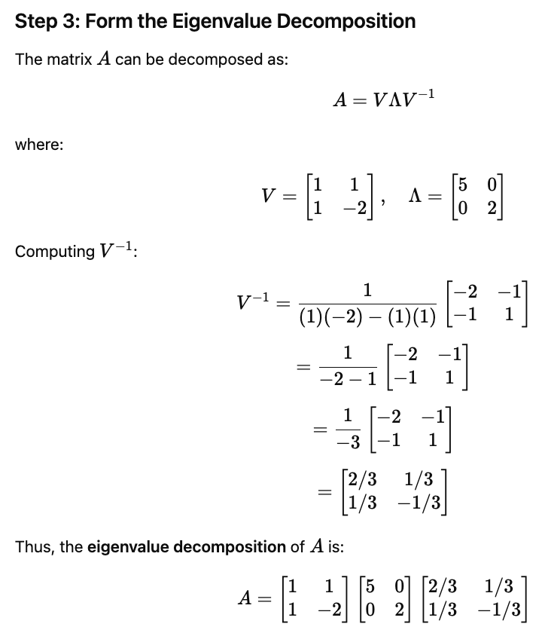
Sample Question
Perform Eigen Value Decomposition for

Slide 12
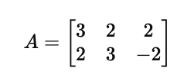
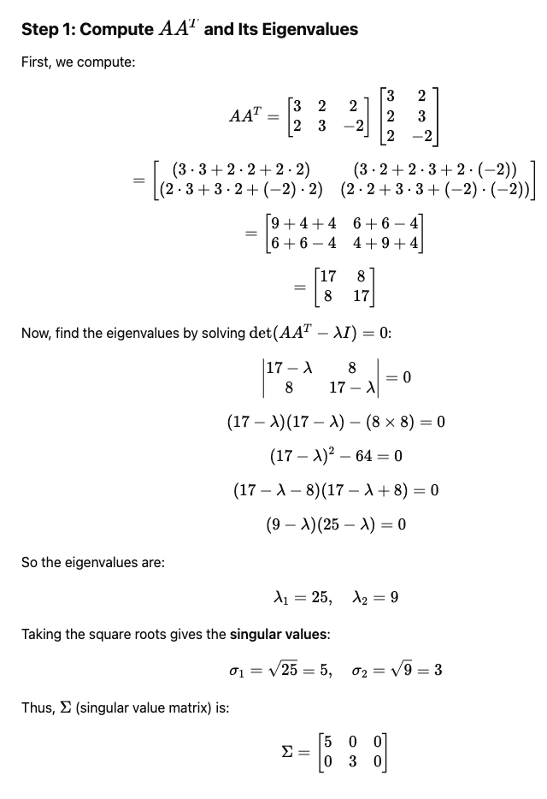
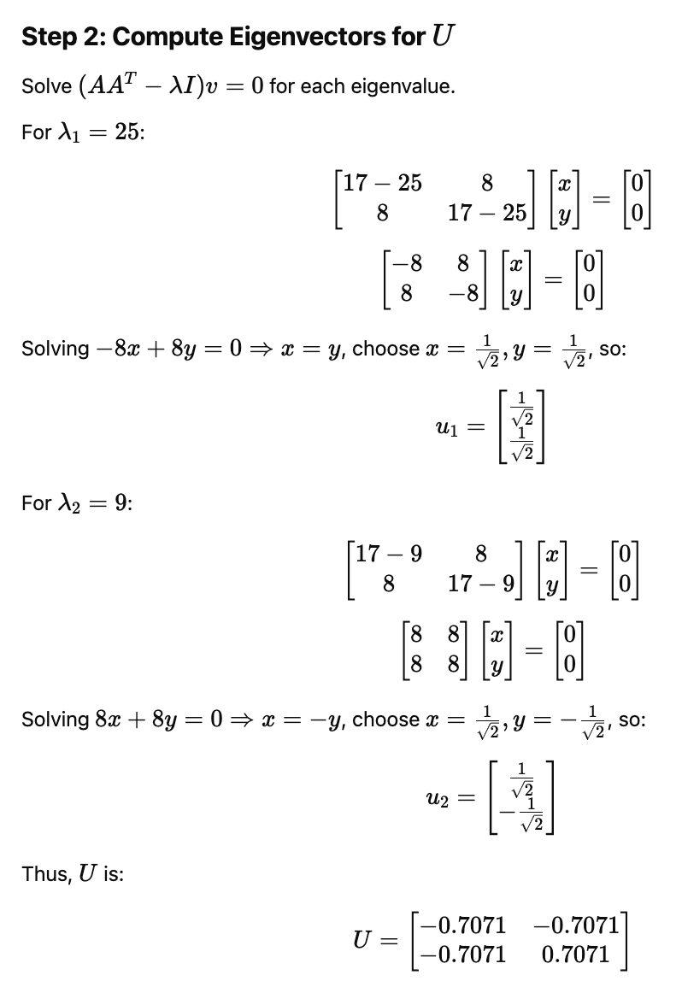
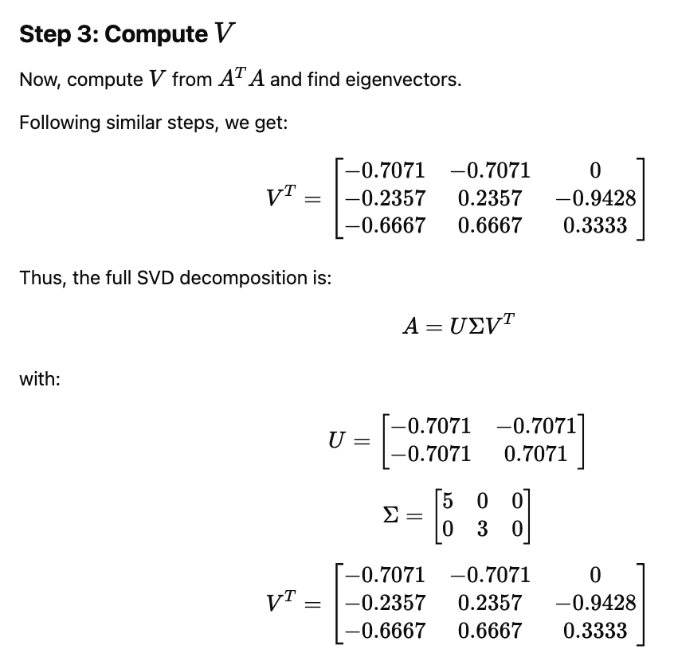
Sample Question
Perform Singular Value Decomposition for

Slide 13
Topics on which Week 5 Assignment Questions are based
Singularity constraint of F and E
Parametric representation of F
Retrieving camera matrices from F
Computing scene points
Line reconstruction
Plane-induced Homography
Affine stereo
Stereo geometry Summary

Slide 14
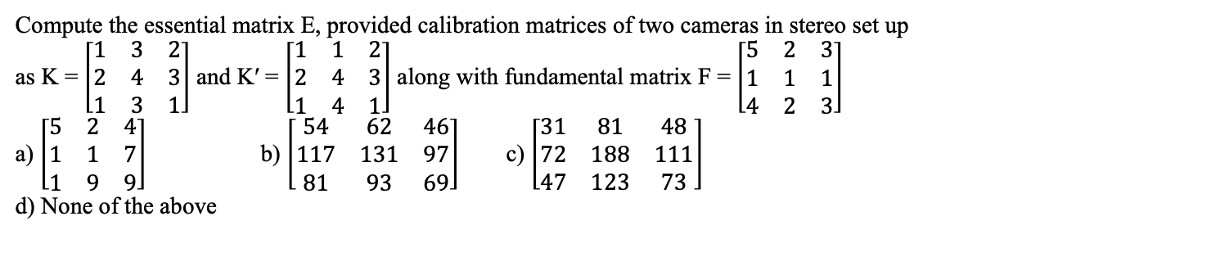
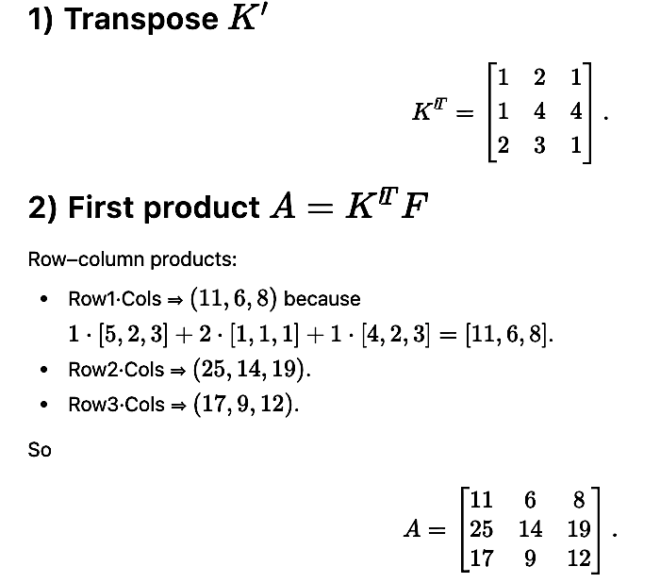
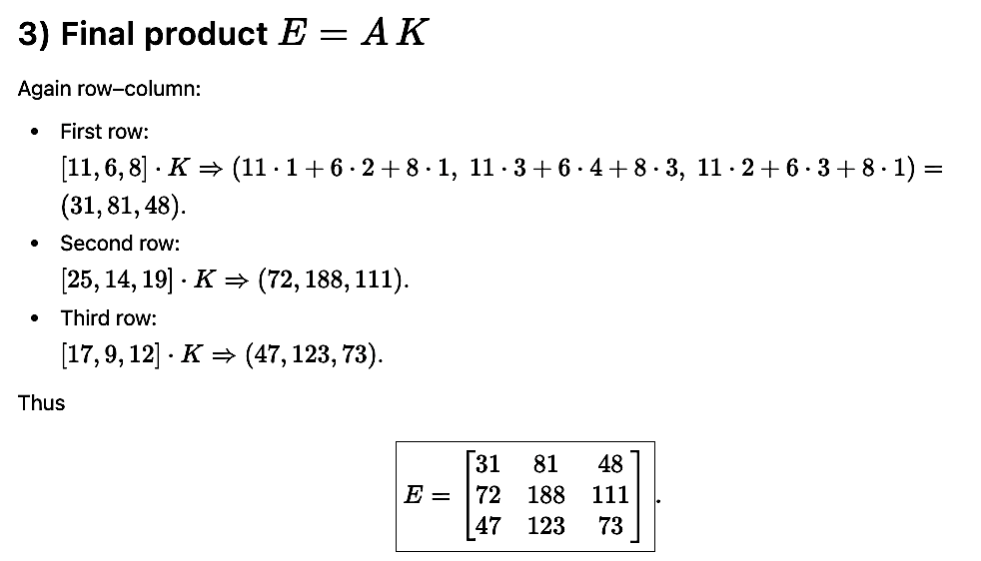


QUESTION 1
SOLUTION 1
CORRECT ANSWER 1
c)

Slide 15





QUESTION 2
SOLUTION 2
Epipolar line l′ = e′ × x′.
CORRECT ANSWER 2
b)

Slide 16



QUESTION 3
SOLUTION 3
CORRECT ANSWER 3
c)

Slide 17






QUESTION 4
SOLUTION 4
CORRECT ANSWER 4
b), d)

Slide 18





QUESTION 5
SOLUTION 5
CORRECT ANSWER 5
b)

Slide 19




QUESTION 6
SOLUTION 6
CORRECT ANSWER 6
b)

Slide 20


QUESTION 7
SOLUTION 7
CORRECT ANSWER 7
c)

Slide 21




QUESTION 8
SOLUTION 8
CORRECT ANSWER 8
d)

Slide 22


QUESTION 9
SOLUTION 9
CORRECT ANSWER 9
b)

Slide 23


QUESTION 10
SOLUTION 10
CORRECT ANSWER 10
a)

